Slide 1
Basic Git Tutorial
Yunruo Ni
Kolachalama Laboratory

Slide 2
Outline
What is Git?
Some Git Concepts
Git commands and Examples
Useful Links

Slide 3
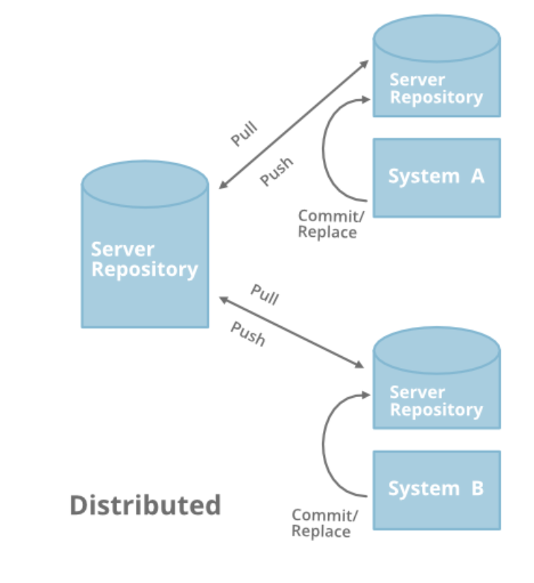
What is Git ?
Git : A Distributed Version Control System for tracking changes in computer files
Distributed version control
Coordinates work between multiple developers
Who made changes and when
Revert back at any time
Notes:
every developer has complete codebase with full version history on their hard-drive.
Changes made to this local repository won’t be visible to anyone until its not uploaded to the server.

Slide 4
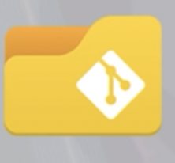
Some Git Concepts
Repository:
→A central location in which data is stored and managed
→A container for a project you want to track with Git
→Like a project folder which Git tracks the contents of for us
→Can have many repos for many different projects in your computer

Slide 5
Main Workflow
Notes:
Working : where the writing happens. This is when you are coding and saving your work
Staging area: when you are happy with a group of changes and use git add command, you are staing your changes
These are like rough draft stored in a bundle
Repository: when you are happy with your commits, you use git commit command to commit them into the repository; like final drafts and stored permanently
Commit: An Operation which saves the changes permanently

Slide 6
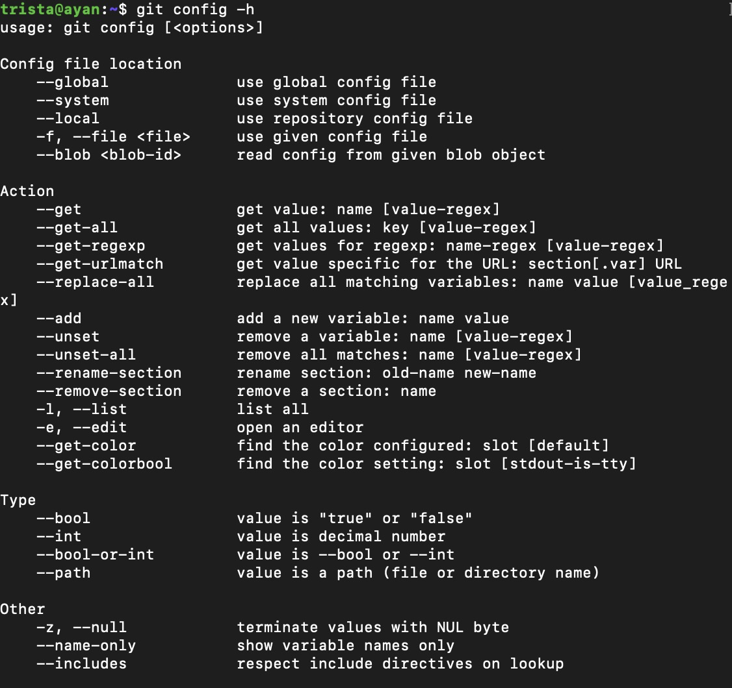
Getting help：git help
$ git help verb. Full page
$ git verb -h
Concise help
Example:$ git config -h

Slide 7
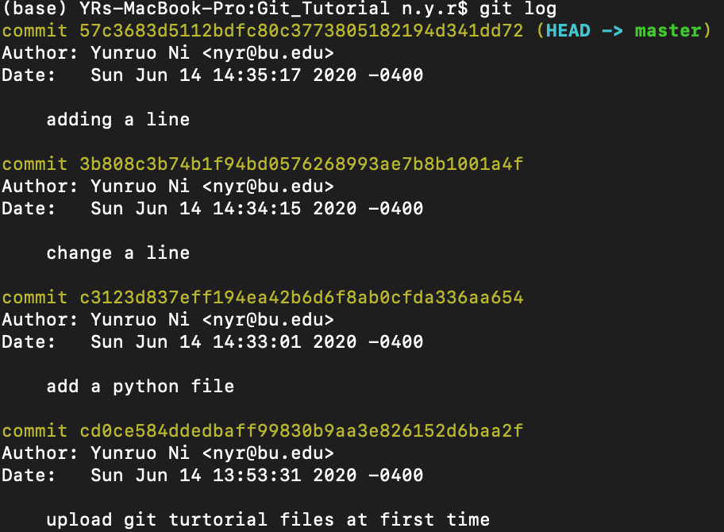
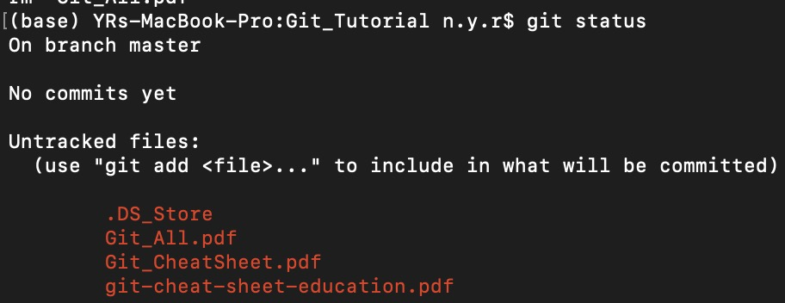
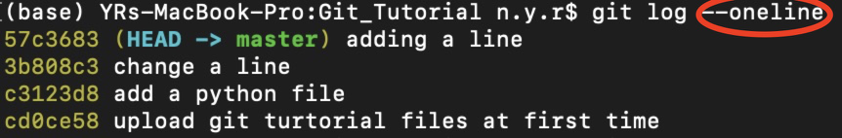
Exploring git repository
Check current status of your repository
git status Execute this commands often
View history of commits
git log
Notes:
Git status:
The Git status command gives us all the necessary information about the current branch.
which file we have changed and which file are in the staging area

Slide 8
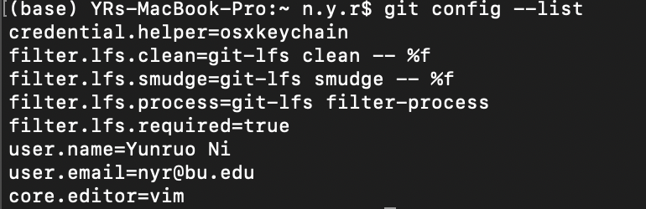
Setting up git :git config
git config: get and set configuration variables that control all aspects of how Git looks and operates.
$ git config --global user.name /**your username**/
$ git config --global user.email /**your email address**/
$ git config --global core.editor /**editor you preferred**/
$ git config --list
Notes:
The first thing you should do when you install Git is to set your user name and email address. This is important because every Git commit uses this information, and it’s immutably baked into the commits you start creating
Now that your identity is set up, you can configure the default text editor that will be used when Git needs you to type in a message. If not configured, Git uses your system’s default editor.
If you want to check your configuration settings, you can use the git config --list command to list all the settings Git can find at that point:

Slide 9
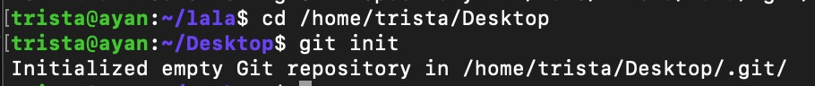
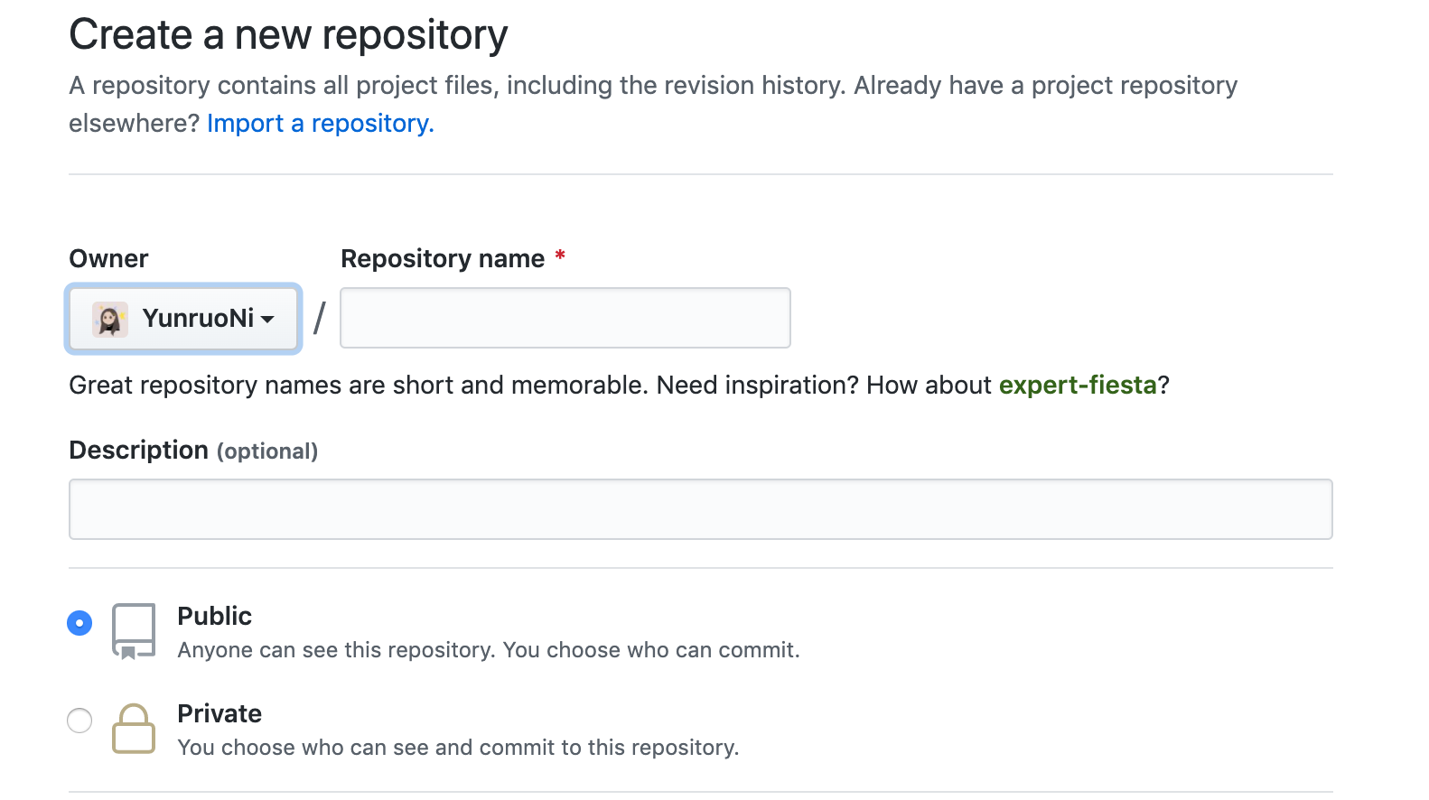
Creating a Repository :git init
― New directory/project git init dirname
― Existing directory
cd /path to/ dirname
git init
― GitHub
Notes:
Git Init: initialize repository on your system
Project folder doesn’t have to be empty for you to create a repository ; we could create a repository in a folder which already has files in it

Slide 10
Cloning Repository :git clone
git clone : Clone a repository into a new directory
Cloning local repository git clone /*path to your local machine*/
Cloning remote repository
git clone https://github.com/**remote path**
Notes:
In other words, Git clone basically makes an identical copy of the latest version of a project in a repository and saves it to your computer.

Slide 11
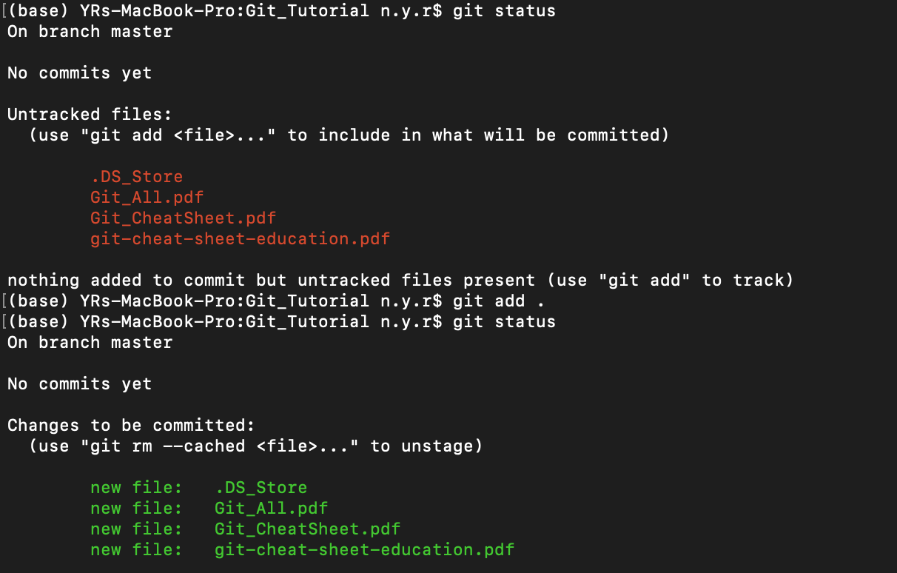
Staging Area: git add
1
2
Repository
Working
Space
Staging Area
1
git | add | file1
git | add | .
git add filename: add this file to staging area
git add . : add every single modified file to the staging area by one command
Notes:
Editing files and adding them to a staging area
When we create, modify or delete a file, these changes will happen in our local and won't be included in the next commit (unless we change the configurations).
We need to use the git add command to include the changes of a file(s) into our next commit.
Since we changed the file but not changed, it will sitting in the modified zone/working space; If we make commit right, it won’t actually commit anything because when we
Git add filename: add this file to staging area
Git add .: add every single modified file to the staging area by one command
security: it will make us to review the changes before we make that to commit; in real, we don’t do commit at any point, we do that after developing certain features of project
We can split our work into separate commit

Slide 12
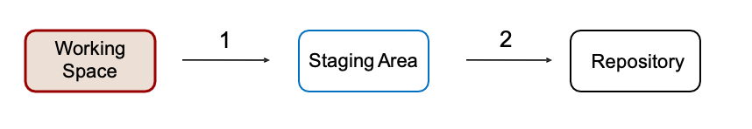
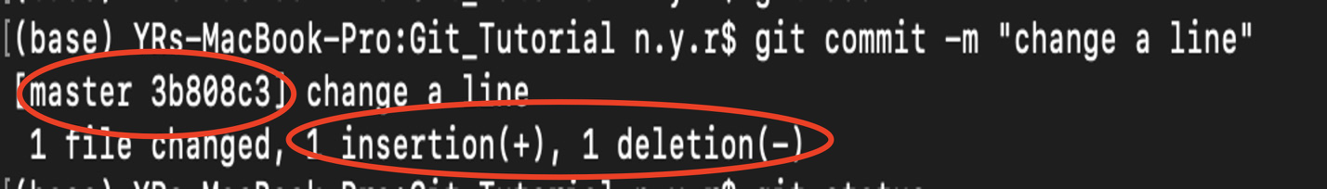
Commit: git commit
2
git commit –m “”: -m means we pass a message and this message should be a descriptive message about what the commit is.
Notes:
“commit”:basically just like a save point it is a snapshot in time of your code at that particular point
Once we reach a certain point in development, we want to save our changes (maybe after a specific task or issue).
Git commit is like setting a checkpoint in the development process which you can go back to later if needed.
We also need to write a short message to explain what we have developed or changed in the source code.
Important: Git commit saves your changes only locally.
If we change word of line; git recognize as we delete that line and reedit it.

Slide 13
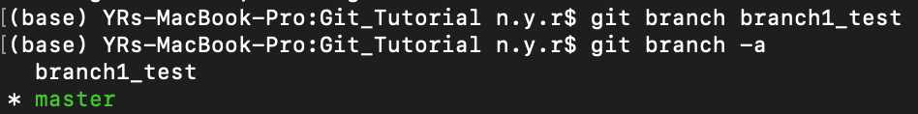
Branch : git branch
git branch branch_name: create a branch
git branch –d/-D branch_name: delete a branch
git branch –a: show all branches
git checkout branch_name: check specific branch
git checkout –b branch_name: create a branch and switch to that branch
Notes:
Branches are highly important in the git world. By using branches, several developers are able to work in parallel on the same project simultaneously. We can use the git branch command for creating, listing and deleting branches.
To work in a branch, first you need to switch to it. We use git checkout mostly for switching from one branch to another. We can also use it for checking out files and commits.
There is also a shortcut command that allows you to create and switch to a branch at the same time

Slide 14
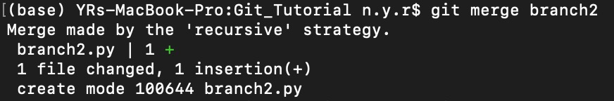
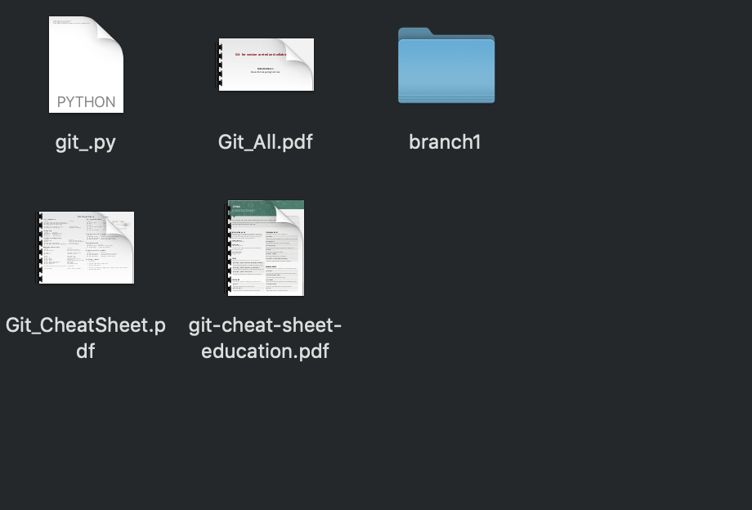
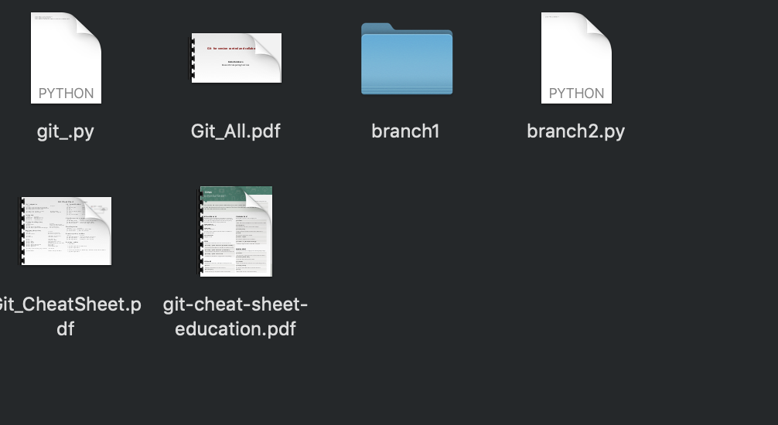
Merge Branch: git merge
git merge branch_name: merge your branch
Notes:
When you've completed development in your branch and everything works fine, the final step is merging the branch with the parent branch (dev or master). This is done with the git merge command.
We have to be in the branch which we want to merge into

Slide 15
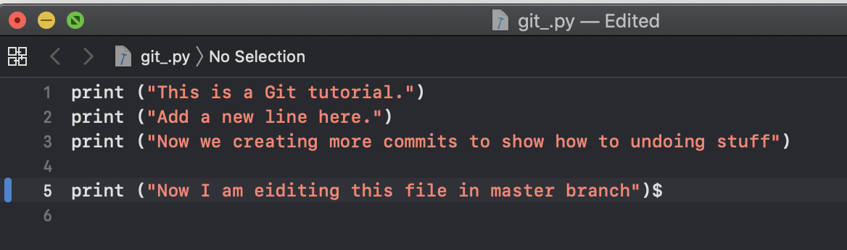
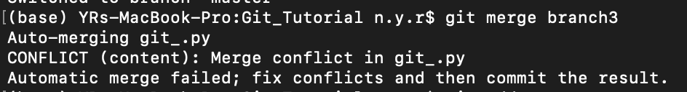
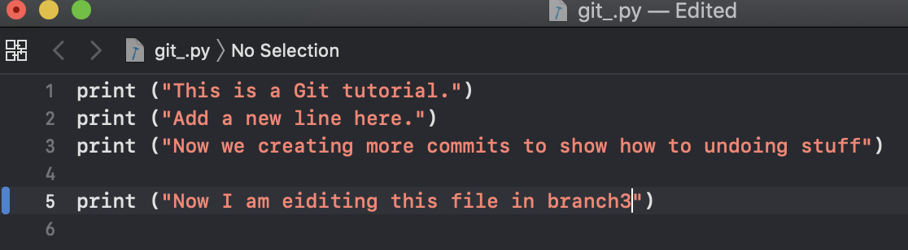
Resolving Merging Conflicts
Example:
In master branch
In branch3

Slide 16
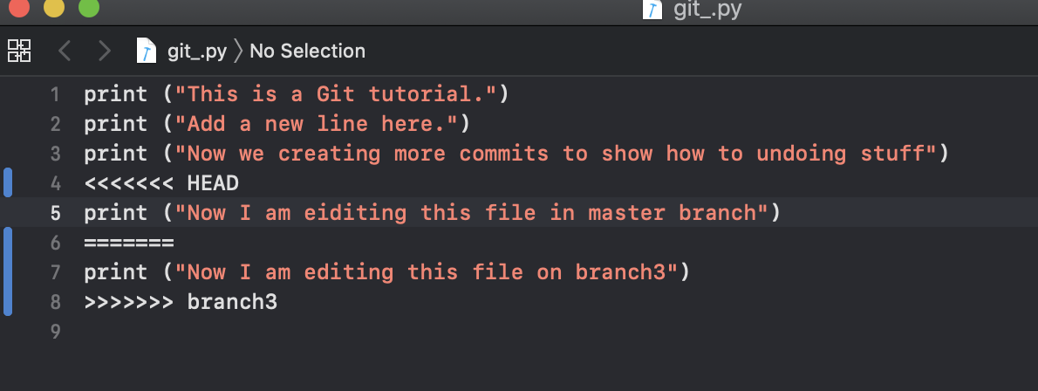
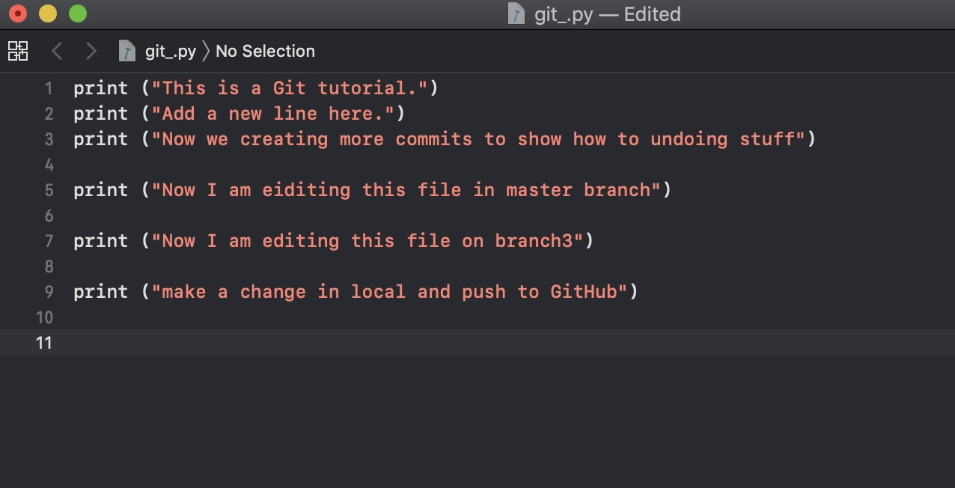
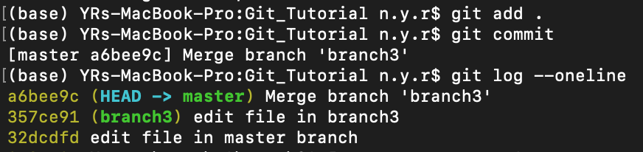
Resolving Merging Conflicts
What does code look like?
Notes:
Git can rack the changes but can’t make decisions , so you need to decide which version you want

Slide 17
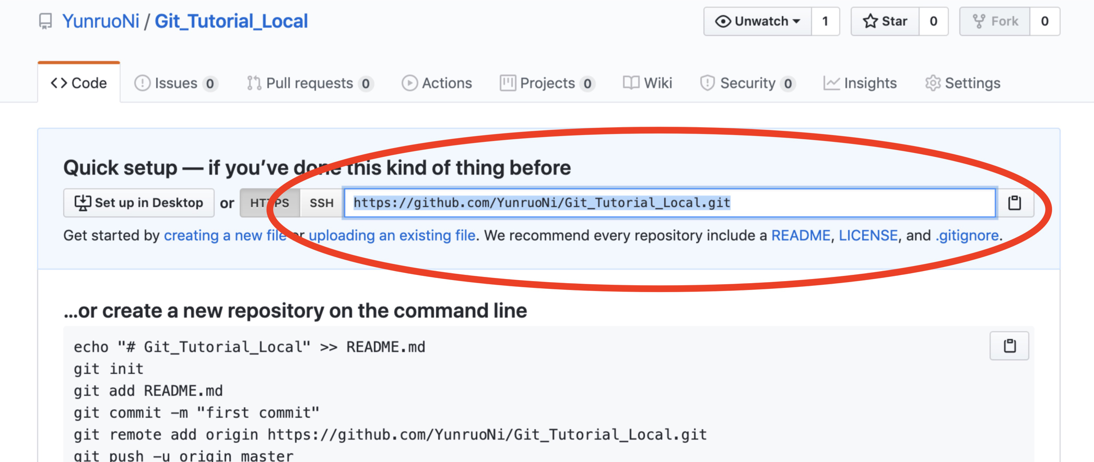
Collaboration: Working with GitHub
Case 1: Already have a local project

Slide 18
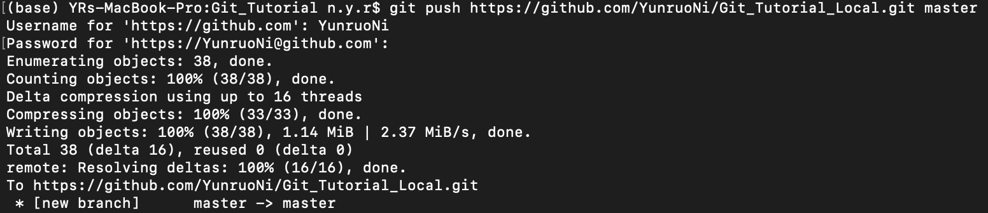
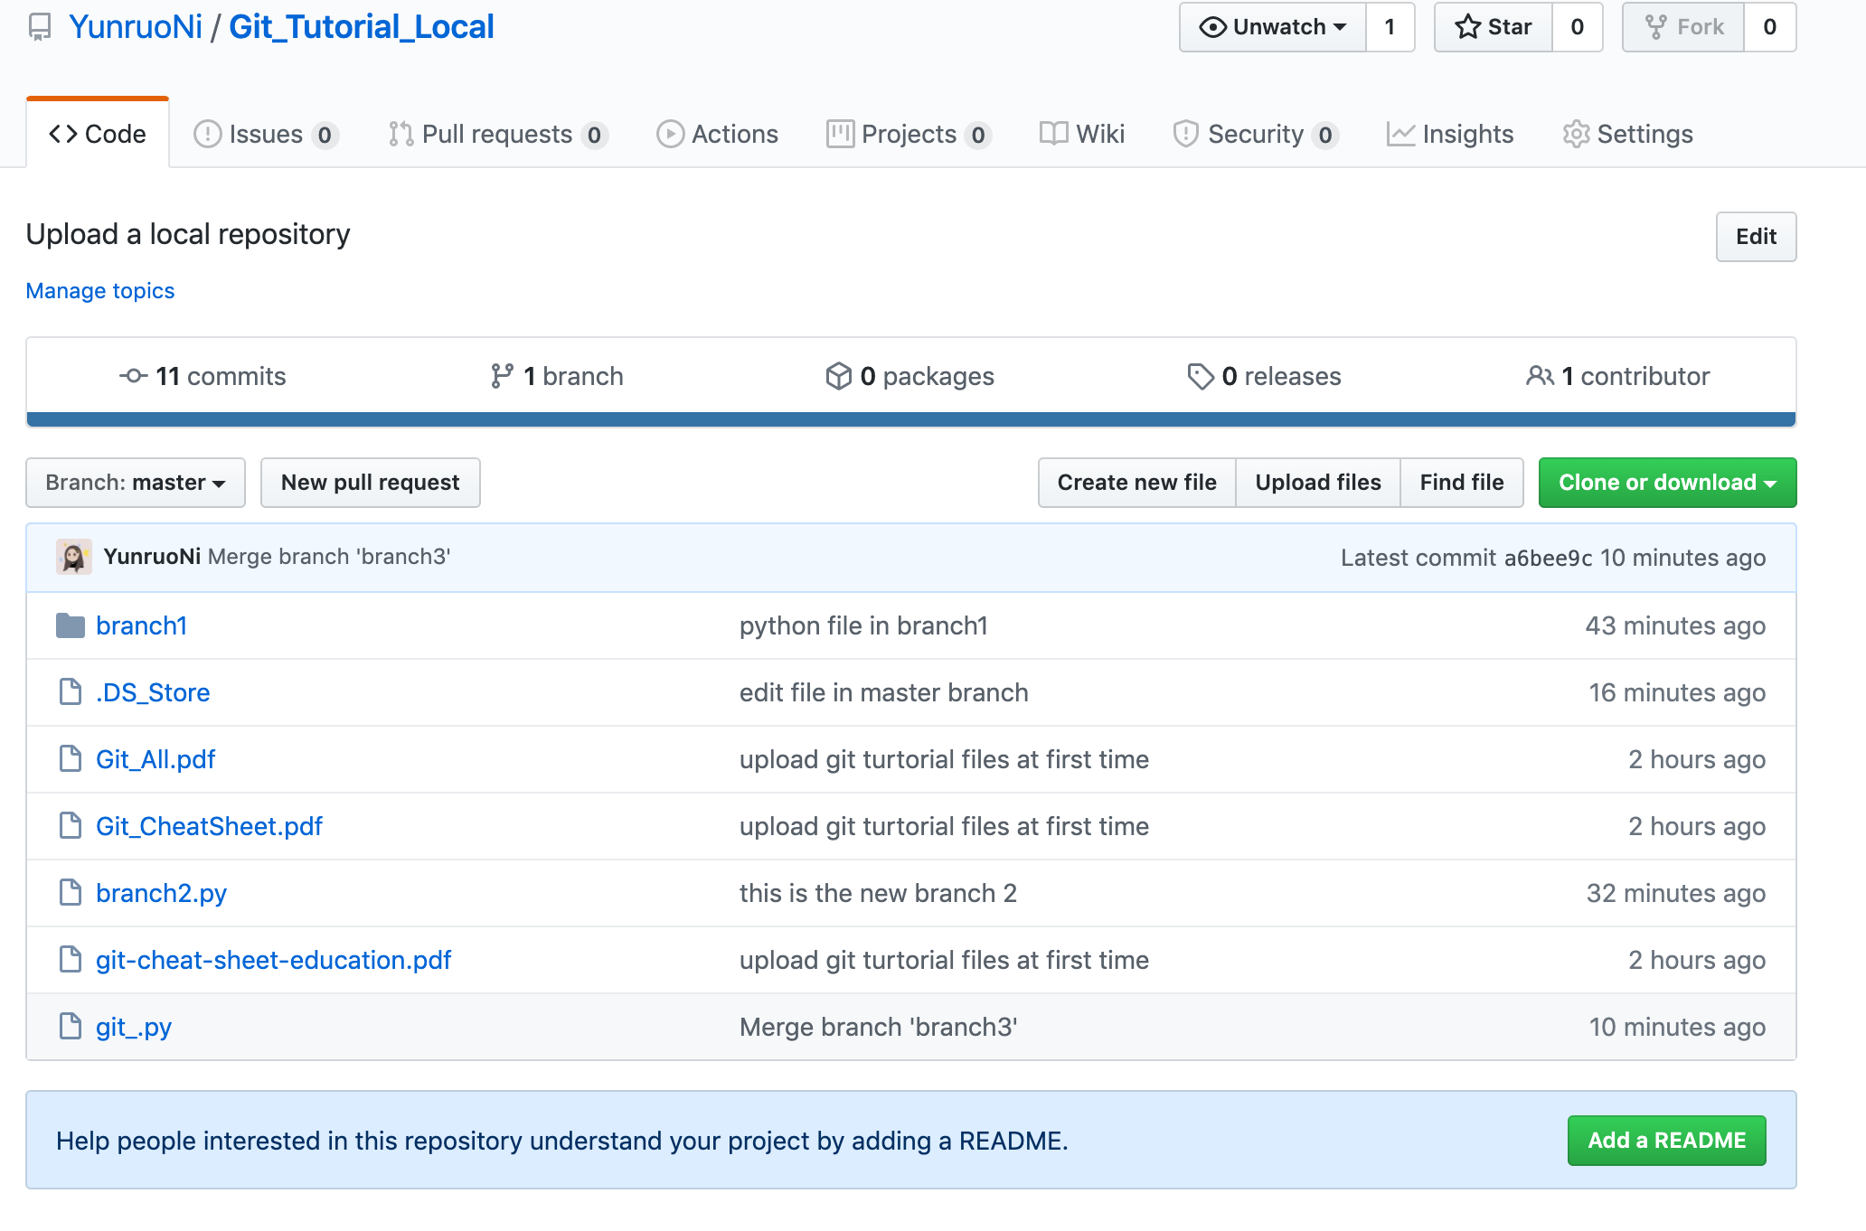
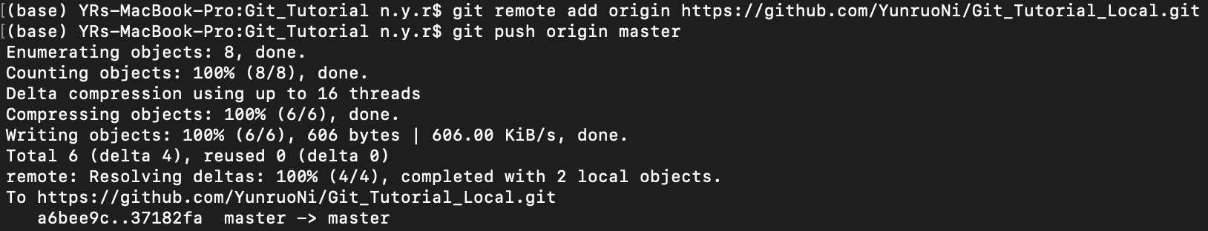
Collaboration: Working with GitHub
Upload local project to GitHub : git push
Set Alias : git remote add *varaiable name* /remote link/
Notes:
After committing your changes, the next thing you want to do is send your changes to the remote server.
Git push uploads your commits to the remote repository.
Git push only uploads changes that are committed
git remote
Usage: git remote add [variable name] [Remote Server Link]
This command is used to connect your local repository to the remote server.

Slide 19
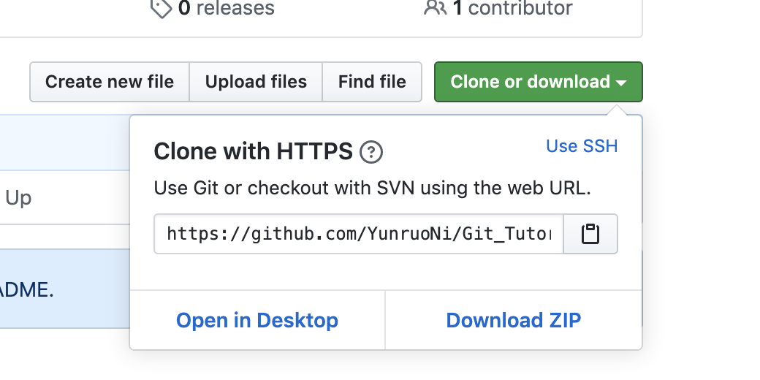
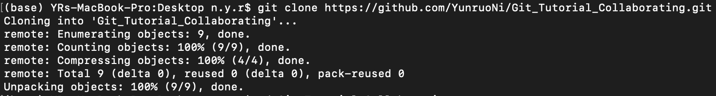
Collaboration : Working with GitHub
Case 2: Work on a Remote Project
Step 1) clone the project: git clone
Step 2) Keep up to date: git pull
Notes:
The git pull command is used to get updates from the remote repo.
This command is a combination of git fetch and git merge which means that, when we use git pull, it gets the updates from remote repository (git fetch) and immediately applies the latest changes in your local (git merge).

Slide 20
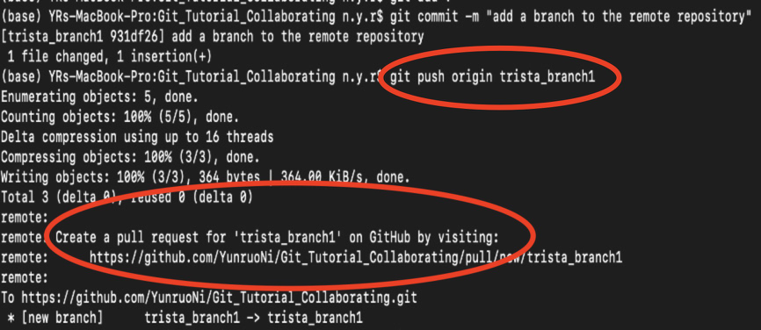
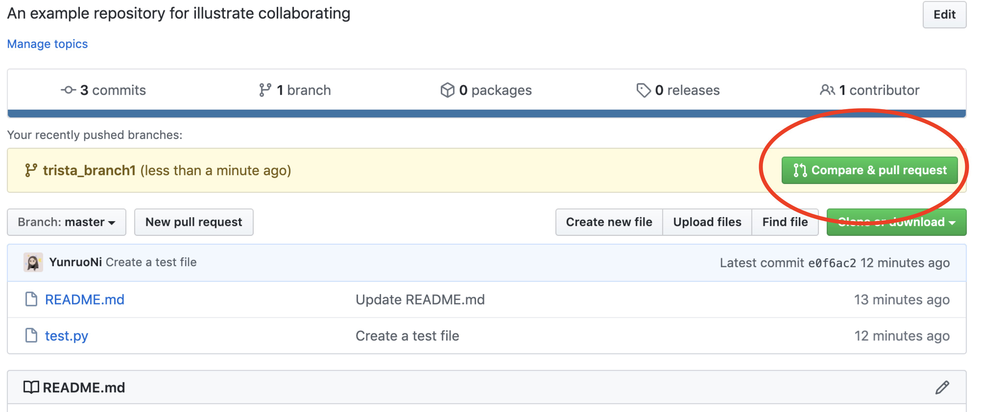
Collaboration : Working with GitHub
Step 3) Make Changes and Upload to GitHub

Slide 21
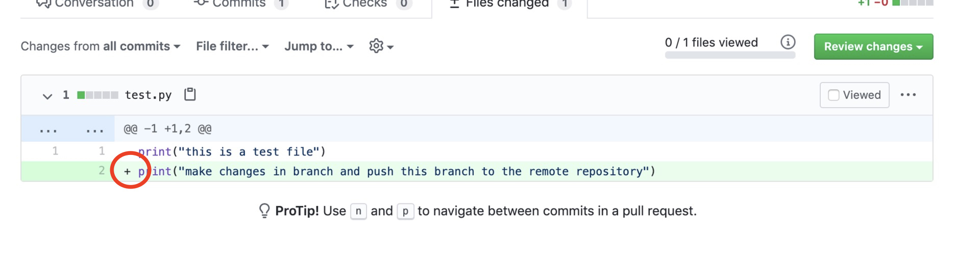
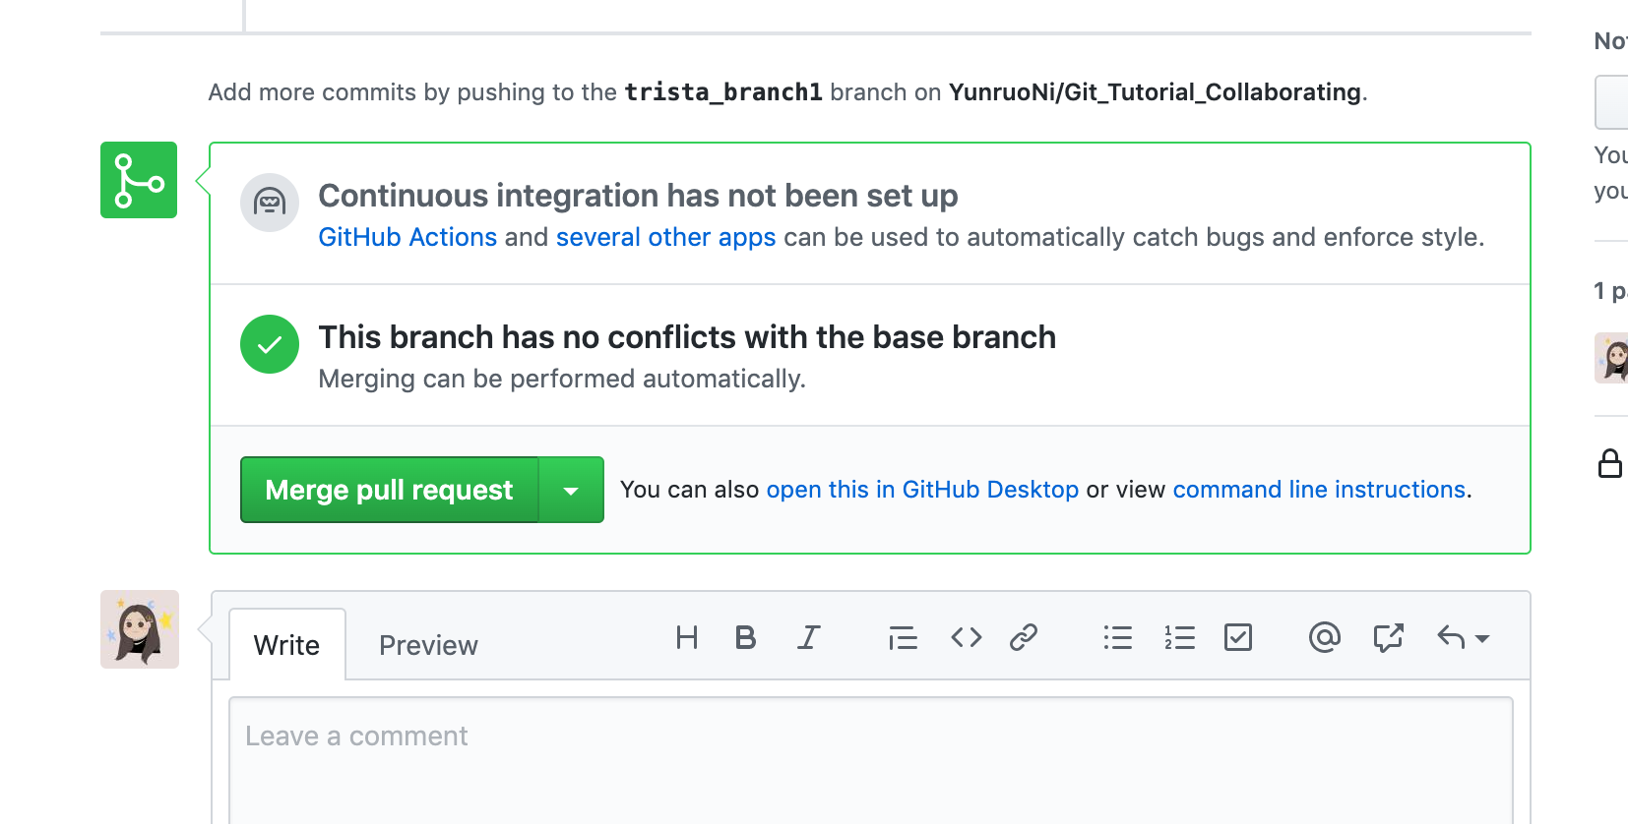
Collaboration : Working with GitHub

Slide 22
Other Commands
git diff
→ shows the file differences which are not yet staged
git rm
→This command deletes the file from your working directory and stages the deletion.
git show [commit]
→This command shows the metadata and content changes of the specified commit.
git stash save
→This command temporarily stores all the modified tracked files.

Slide 23
Useful Links
GitHub Documents
https://git-scm.com/doc
2) YouTube Videos
https://www.youtube.com/watch?v=3RjQznt-8kE&list=PL4cUxeGkcC9goXbgTDQ0n_4TBzOO0ocPR
3) Other Articles
https://towardsdatascience.com/top-20-most-frequently-used-git-commands-part-1-5f8c9212509f
4) Yunruo Ni’s GitHub Repositories
https://github.com/YunruoNi/Git_Tutorial.git

